Slide 1
Group:5
1.Salman Farshi
2.Md. Ashiquer Rahman 3.Iftakarul Islam Suvo
Superviser : Shahnewaz Siddique

Slide 2
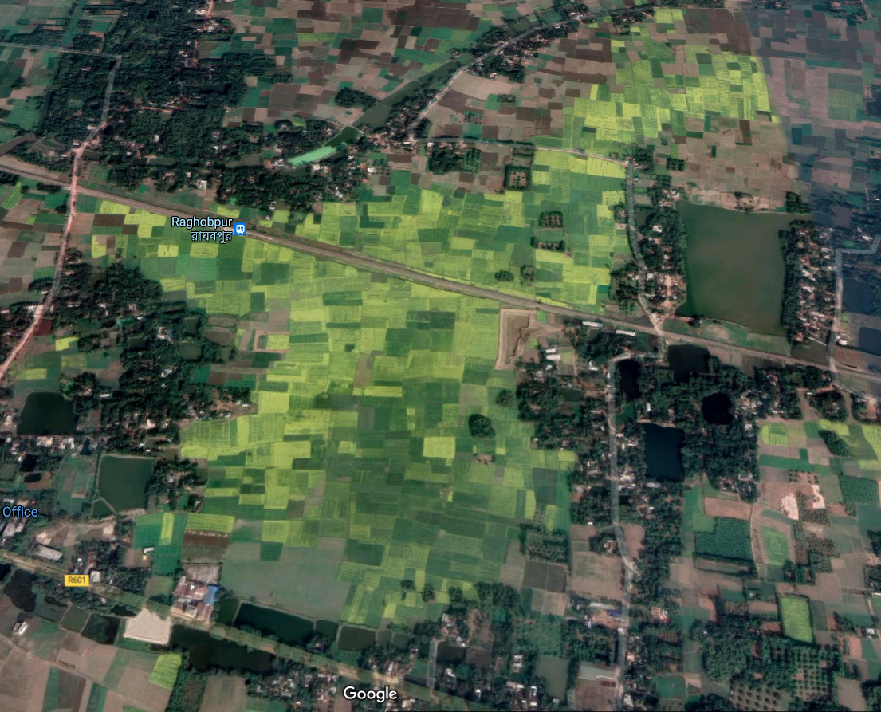
Detecting arable/none_arable land from satellite images using Yolov4

Slide 3
MOTIVATION
1. Bangladesh is a densely populated country. The population here is increasing day by day.
2. Due to this huge increase in population many arable lands are converted to buildings, complex etc. So, we are in a position of lack of farmable lands now.
3. There are also many lands which are arable but farming hasn’t started there yet because of no detection.
4. For this reason, the food production process is being hampered. We are not capable of feeding a huge population of 180 million with farming lands we have now.
5. We must look for new farmable lands across the country

Slide 4
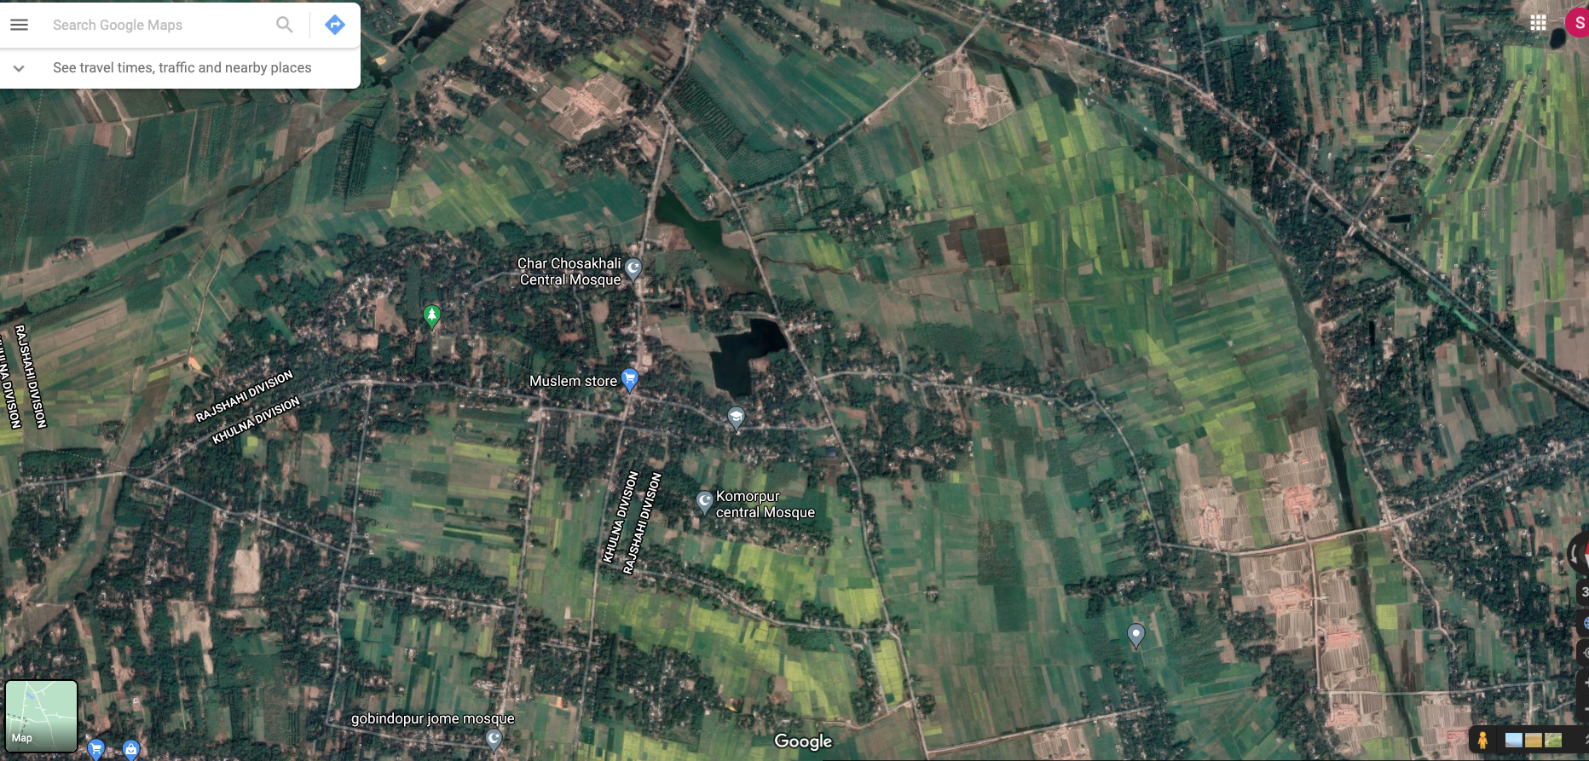

Slide 5
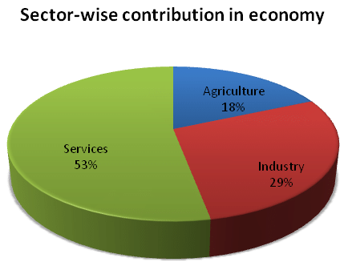
MOTIVATION
Why Deep learning for Agriculture ?
If computer has vision , so why not use of it
1.Easy to Detect
2.Short Time
3.Less Costly 4.Easy to Manage 5.Better Accuracy

Slide 6
What is Yolov4?
What is YOLO?
YOLO stands for You Only Look Once. YOLO is a state-of-the-art, real-time object detection system. It was developed by Joseph Redmon. It is a real-time object recognition system that can recognize multiple objects in a single frame. YOLO has evolved into newer versions over time, viz., YOLOv2, YOLOv3, and YOLOv4.
What is YOLOv4?
YOLOv4 is an object detection algorithm that is an evolution of the YOLOv3 model. The YOLOv4 method was created by Alexey Bochkovskiy, Chien-Yao Wang, and Hong-Yuan Mark Liao.

Slide 7
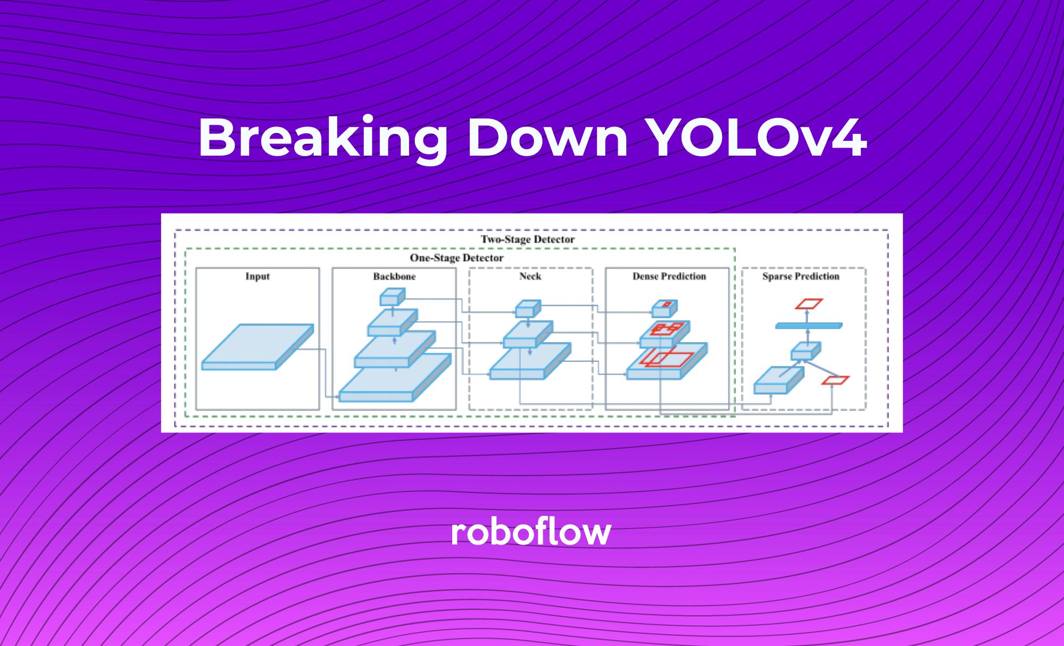
How does it work?

Slide 8
Project workflow
Information gathering
image collection
Image preprossesing
Annotatation
Enviroment setup
Data training
Data testing
Result evalution

Slide 9
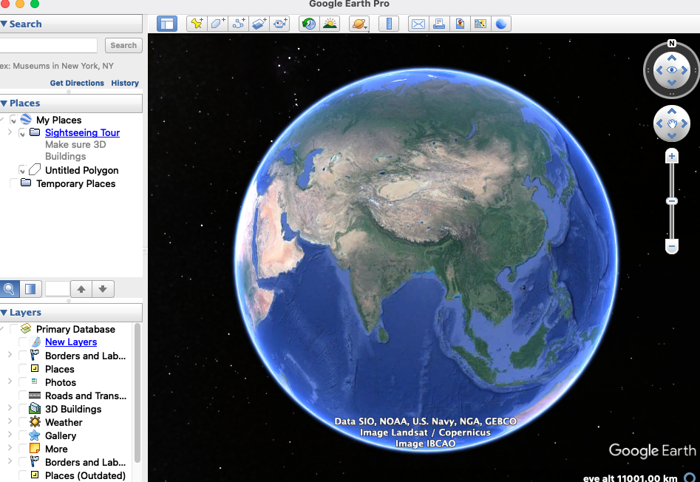
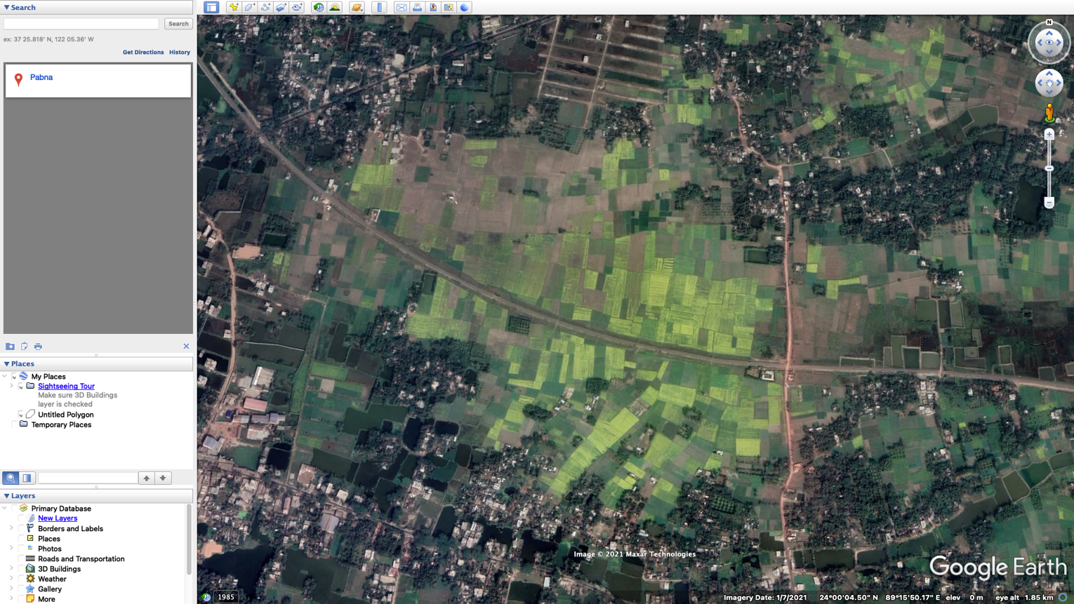
Image collection

Slide 10
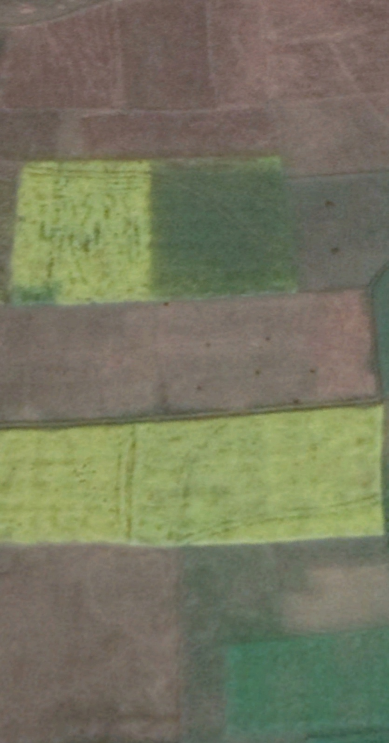
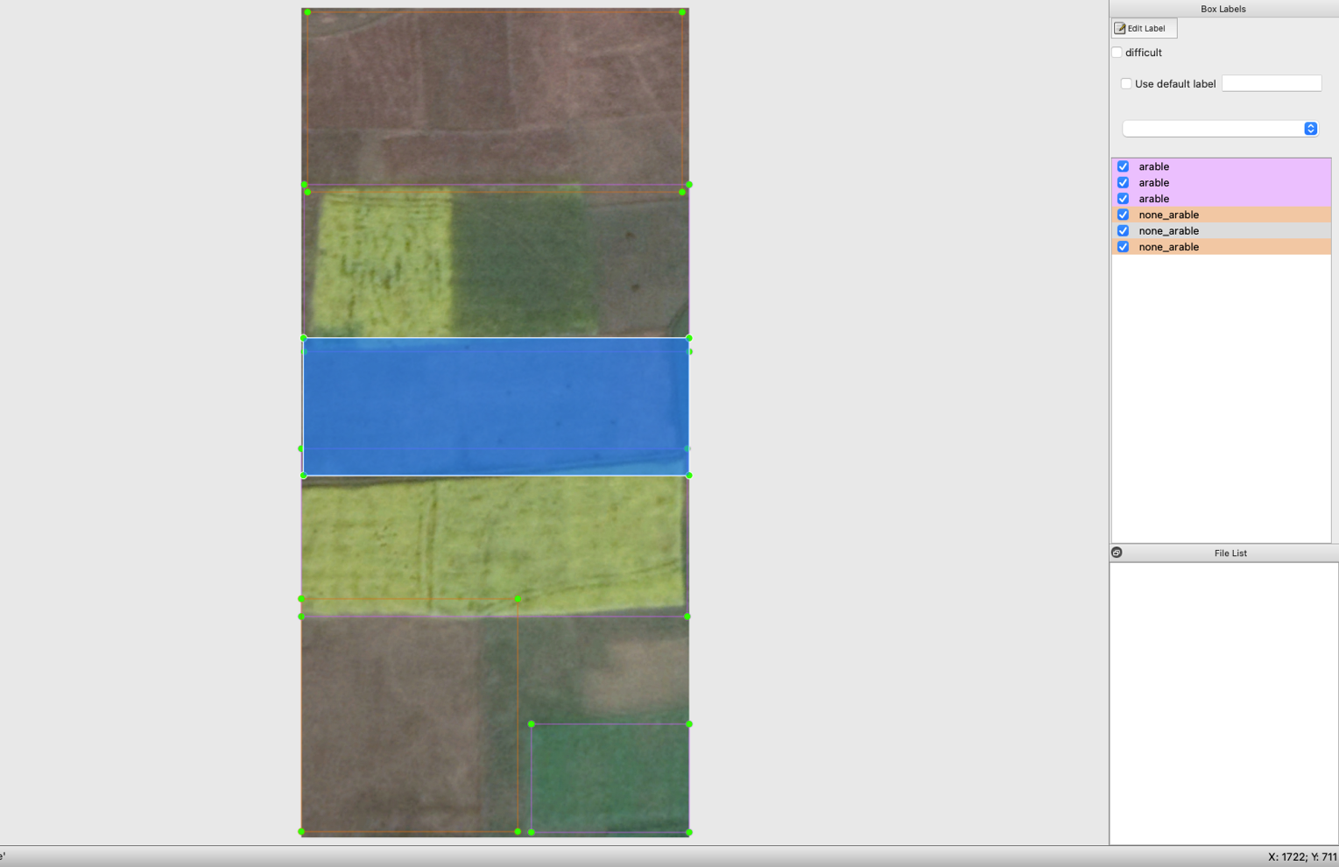
Image Pre processing and annotation

Slide 11
Training &Testing
After collecting images through Google earth and labelled data; we divided the data into two parts. First part is 80%, training data; rest 20% are testing data
We have run 6000 iterations through the training data. Without 6000 iterations a full result wasn’t possible. We got the most accuracy at 2000 iterations. The accuracy at that point was 76%. After that point, the accuracy went downwards and stopped at 60%65%. So, we stored the primary 2000 iterations as best weight. The precision was 78%, recall was 77% F1 score was 76%. Mean average precision or accuracy was 76%.

Slide 12
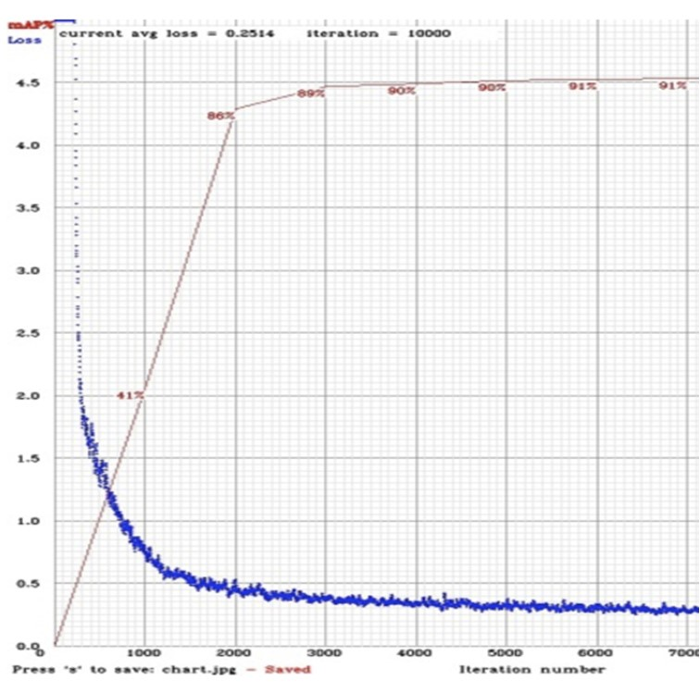
Results & output
mean average precision (mAP@0.50) = 0.76, or 76%
arable:80%
none_arable:73%
Precision | Recall | F1-Score
0.78 | .77 | .76

Slide 13
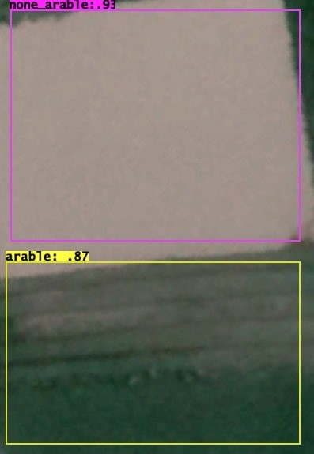
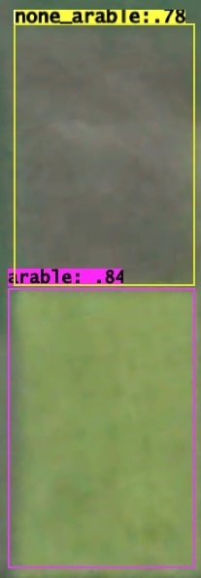
Output

Slide 14
Disscusion
In these iterations, we saw that, the framework can detect Arable lands more accurately almost 80%. Non Arable land detection was a little bit lower than that, 73%. The reason behind getting 80% is, the image colore was quite good for Arable lands. The green color was more accurately detected by the algorithm. The non arable (not pure green) lands were less light reflected and were not so bright. We could have more accuracy if we had used a huge amount of images like 20,000 – 30,000. Because the algorithm gives more accurate result for more images

Slide 15
Future work
We have completed our research successfully. Our algorithm could Arable & non Arable lands successfully upto 76%. In the near future, we would like to add a bigger picture to the research. We will collect 15,000-20,000 images in order to measure accuracy. Hopefully, our result will be more accurate then. As we mentioned before, if our research becomes successful in Bangladesh, we will do the same for the countries alike to Bangladesh. We hope to achieve our goal very soon

Slide 16
Conclusion
Using the ‘YOLO v4’ algorithm to detect lands was a great achievement for us. We did label the images pretty much correctly with ‘LabelImg’. Our data was unique also as it is based on districts on Bangladesh. Hopefully, this result will contribute to reduce the food crisis problem of Bangladesh perfectly and very soon we will be citizens of a country where there is no food crisis.

Slide 17
THANK YOU

